Slide 1

Data Description
Session 6
M. Kachour

Slide 2
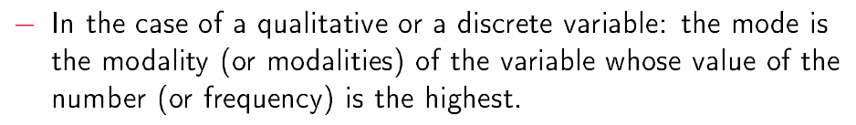
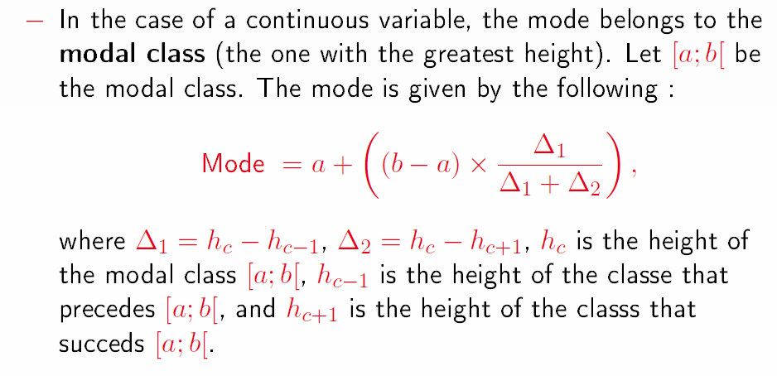
Position Indicators – Mode
The best represented observation of the observed data is called the mode.
The mode is considered as a central value associated with the data.
Note that the mode is not necessarily a single value.

Slide 3
Examples – calculation of the mode
Example 1: The data below represents the wage distribution of 15 employees working in a small business
Identify the mode(s)associated with data.
Salary | Number of employees
1300 | 3
1850 | 5
2050 | 5
3000 | 2

Slide 4
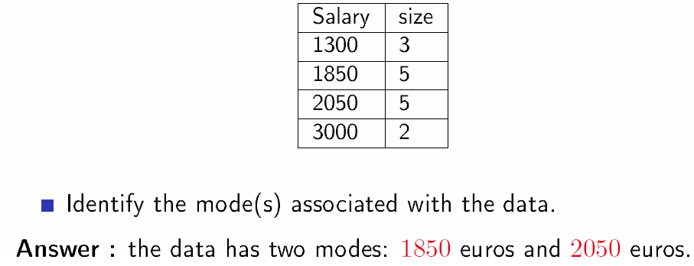
Examples – calculation of the mode
Example 1: The data below represents the wage distribution of 15 employees working in a small business

Slide 5
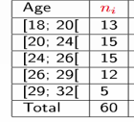
Examples – calculation of the mode
Example 2: The data below represents the ages of 60 candidates in a competition
Identify the mode(s)associated with data.

Slide 6
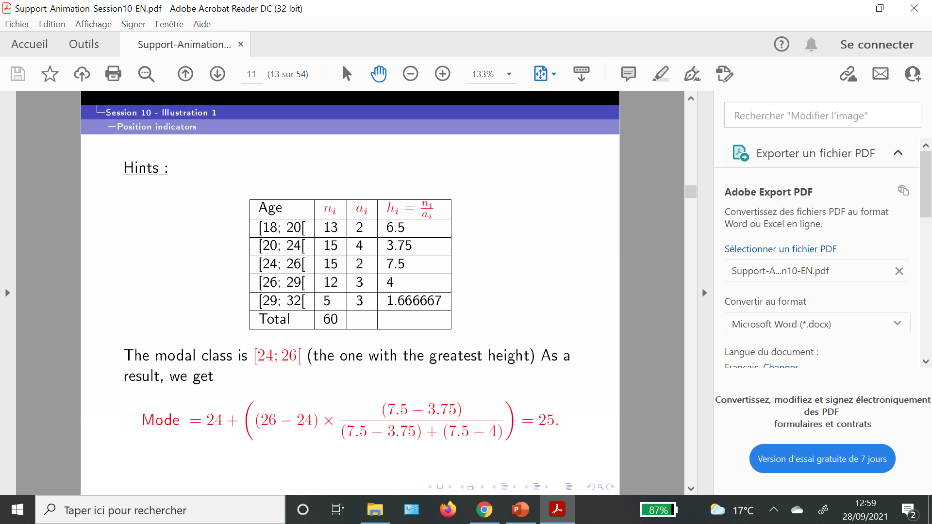
Examples – calculation of the mode
Example 2: The data below represents the ages of 60 candidates in a competition

Slide 7
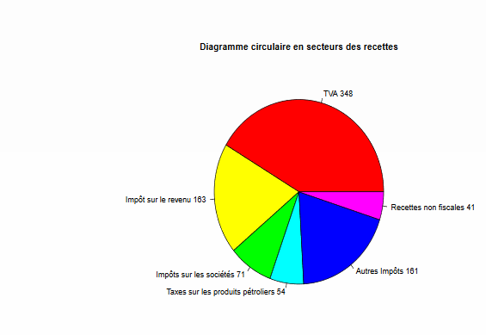
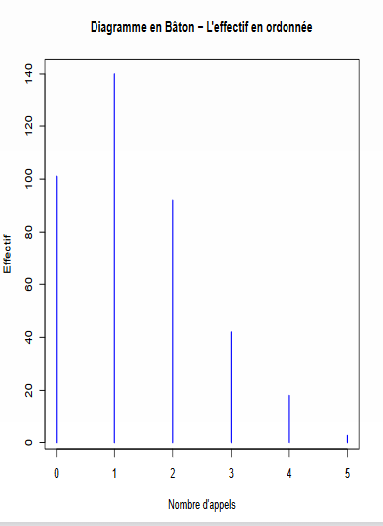
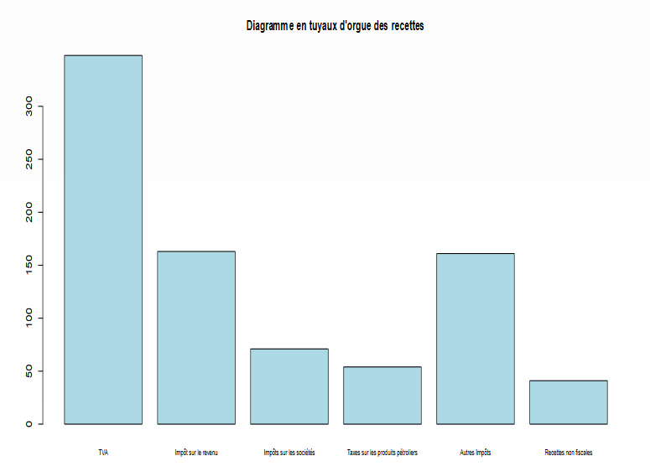
The mode - Graphically

Slide 8
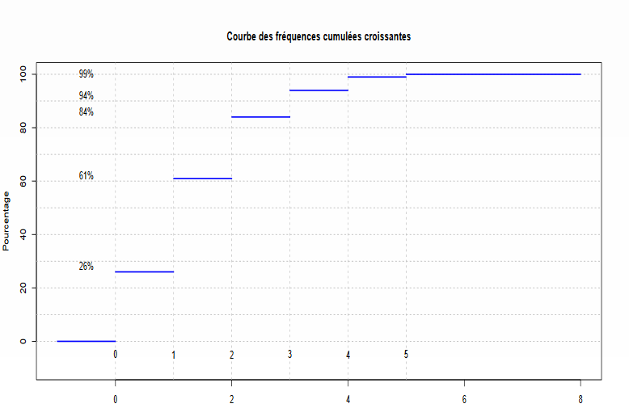
The mode - Graphically
The highest step

Slide 9
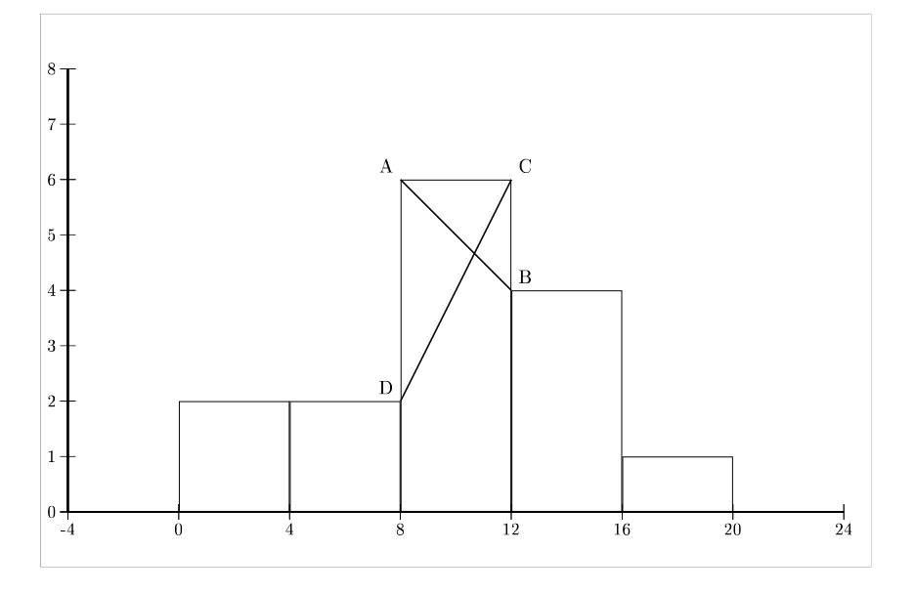
The mode - Graphically

Slide 10
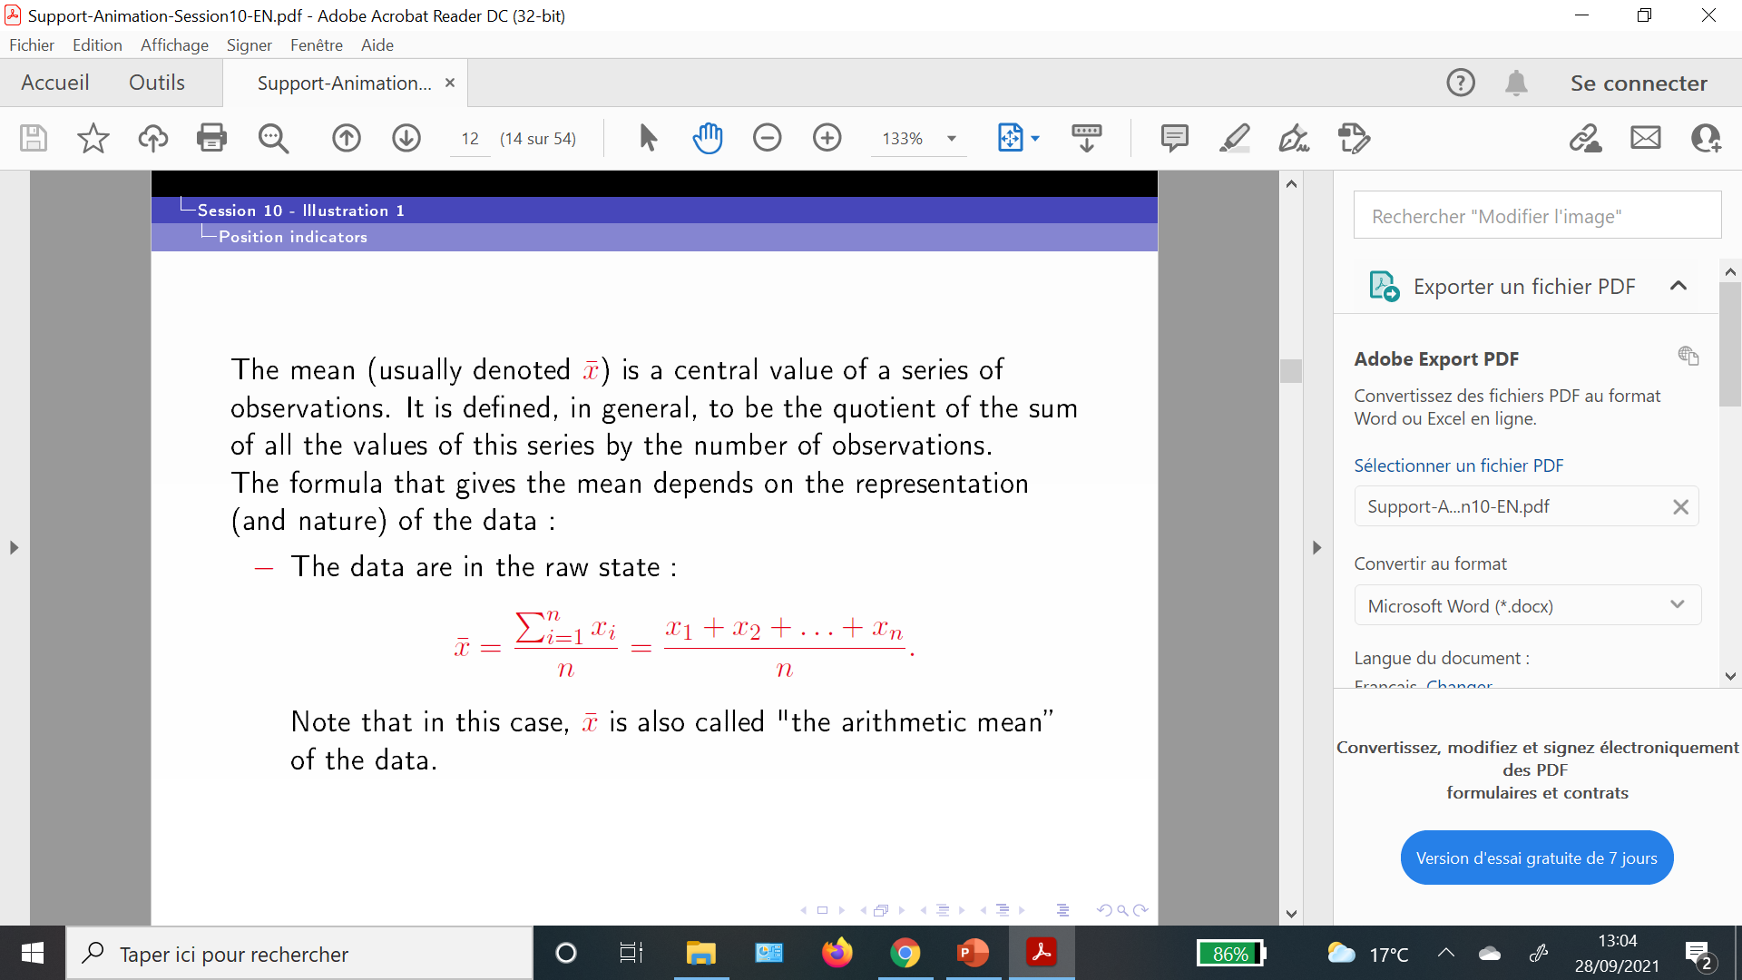
Position indicators – The mean
Indicator associated with data from a quantitative variable only

Slide 11
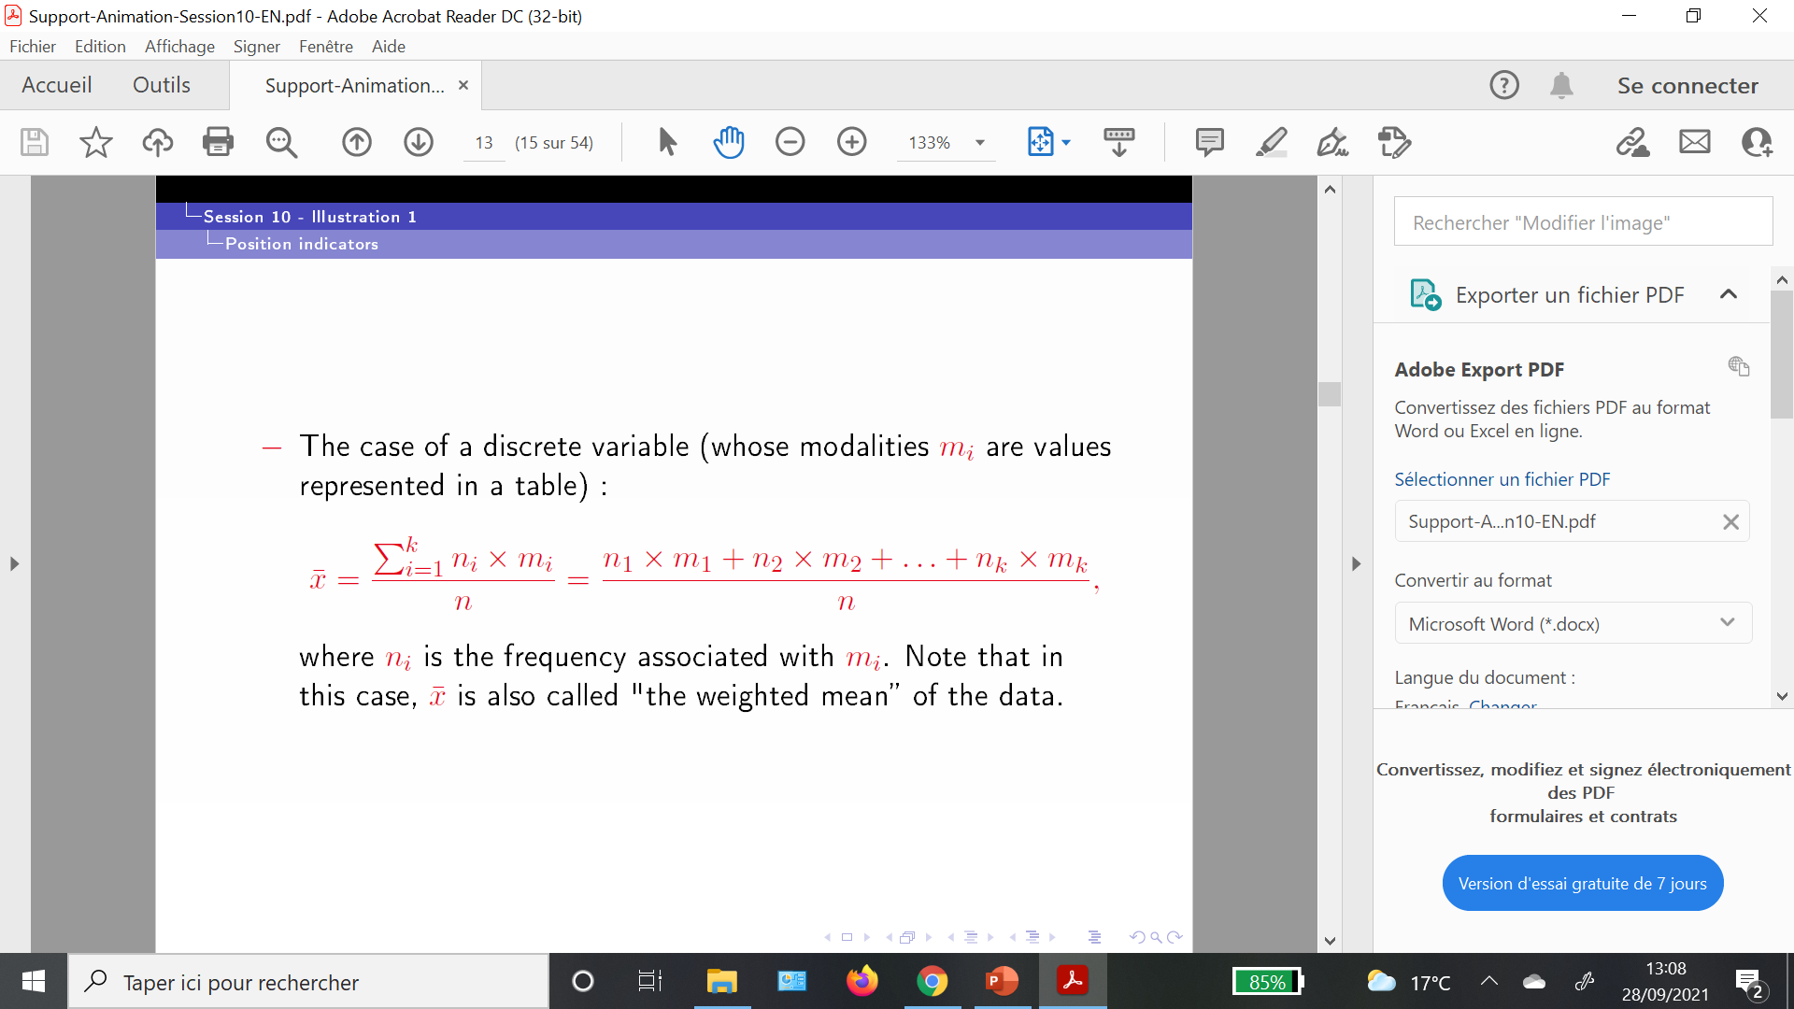
Position indicators – The mean

Slide 12

Position indicators – The mean

Slide 13
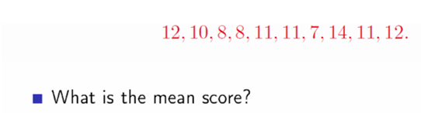
Examples - calculation of the mean
Example 1 :
The data below represents the grades / scores of 10 students

Slide 14
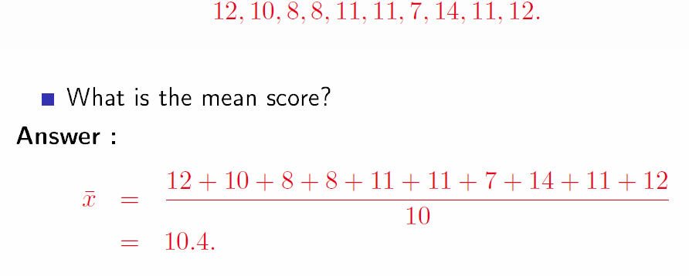
Examples - calculation of the mean
Example 1 :
The data below represents the grades / scores of 10 students

Slide 15
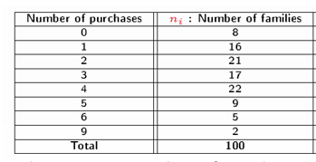
Examples - calculation of the mean
Example 2 :
The data below represent the number of purchases (per week) of a product studied out of 100 French families.
Calculate the mean.

Slide 16
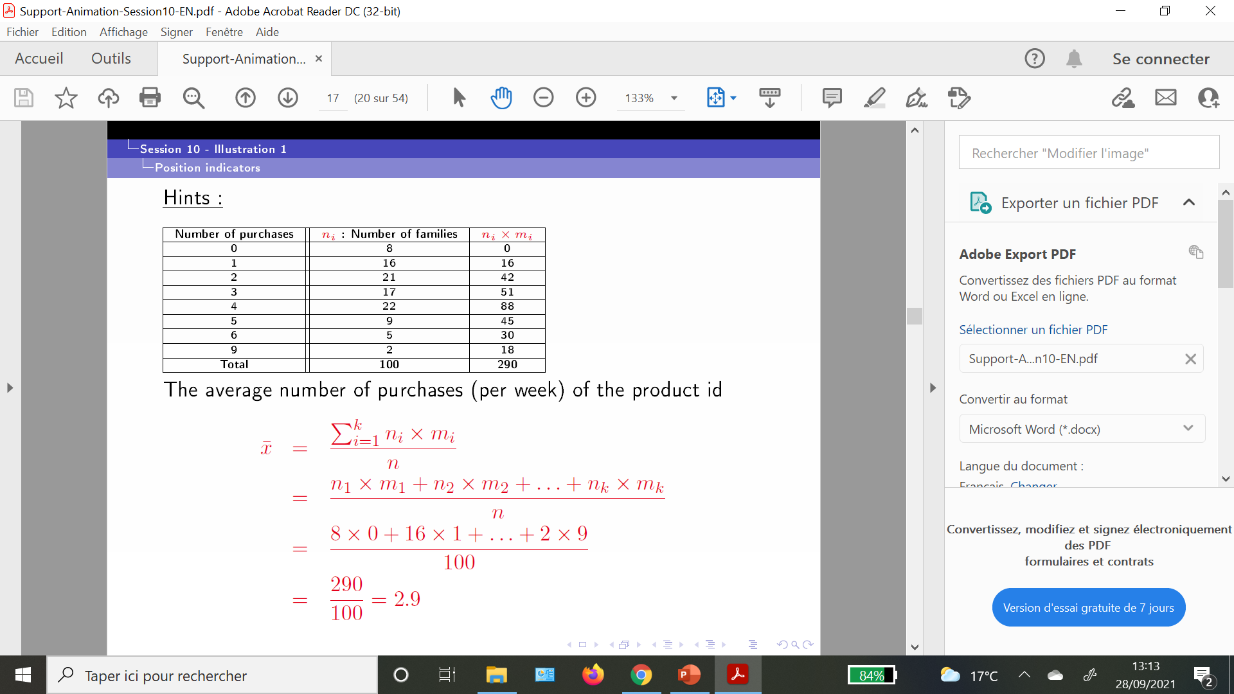
Examples - calculation of the mean
Example 2 :

Slide 17
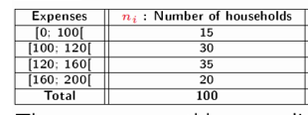
Examples - calculation of the mean
Example 3 :
The data below represents the monthly expenses of 100 households for the purchase of a certain product
Calculate the mean monthly expenses.

Slide 18
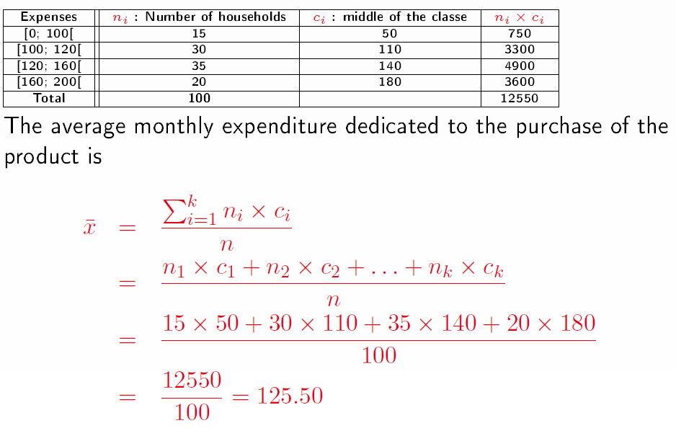
Examples - calculation of the mean
Example 3 :

Slide 19
Exercise
The data below represents the age of visitors to a website:
Age | Number of visitors
< 18 | 5
[18 ; 20[ | 15
[20 ; 30[ | 20
[30 ; 35[ | 30
[35 ; 50[ | 23
≥ 50 | 7
Find the right proposal (among the four proposals below) :
[30; 35[ is the modal class
55 is the center of the last class
The mode is equal to 19 years
The average age is equal to 32.25 years

Slide 20
Exercise
The data below represents the age of visitors to a website:
Age | Number of visitors
< 18 | 5
[18 ; 20[ | 15
[20 ; 30[ | 20
[30 ; 35[ | 30
[35 ; 50[ | 23
≥ 50 | 7
Find the right proposal (among the four proposals below) :
[30; 35[ is the modal class
55 is the center of the last class
The mode is equal to 19 years
The average age is equal to 32.25 years

